Slide 1

Predicting Pseudo Random Values Using Convolutional Neural Networks
Spencer Arnold
Abdinajib Ali
Jacob Anderson
Matthew Hawks
Ryan Hines
Tae Kweon

Slide 2
Introduction
We introduce a novel approach to predicting sequences of given pseudo random number generators (PRNGs) by proposing the use of deep convolutional networks (CNN) in a regression-based supervised learning process.
We also provide an experimental framework for the latter and, in addition to building off of existing prediction models, we demonstrate that the cryptographic strength of each consecutive PRNG increases, while prediction success rates (even with learning) are generally less effective.
Notes:
Tae

Slide 3
PRNG Methods and seeding
Middle-square method (1946)
Linear congruential generator (1958)
Lagged Fibonacci (1965)
Park-Miller (1988)
Mersenne Twister (1998)
Notes:
Najib and Jacob
Talk about seeding methods and issues / Seed method for Lagged Fibonacci

Slide 4
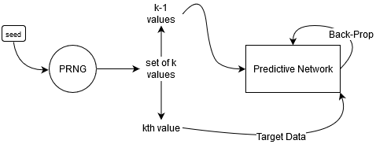
1-D Experimental design
Notes:
Spencer

Slide 5
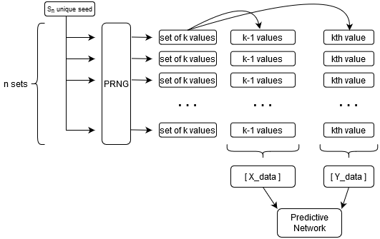
2-D Experimental Design
Notes:
Spencer

Slide 6
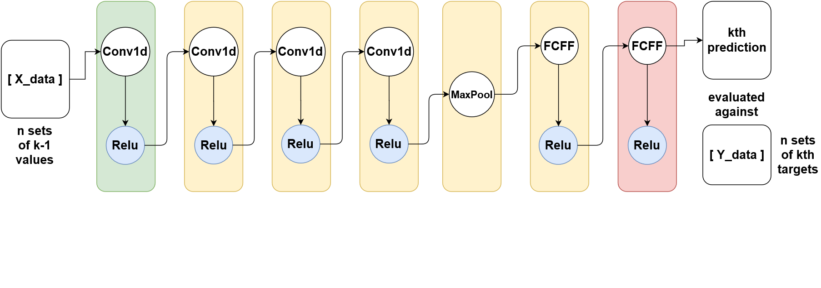
Predictive Model
Notes:
Mention that other research had Leaky-Relu’s… we are aiming for simplicity.

Slide 7
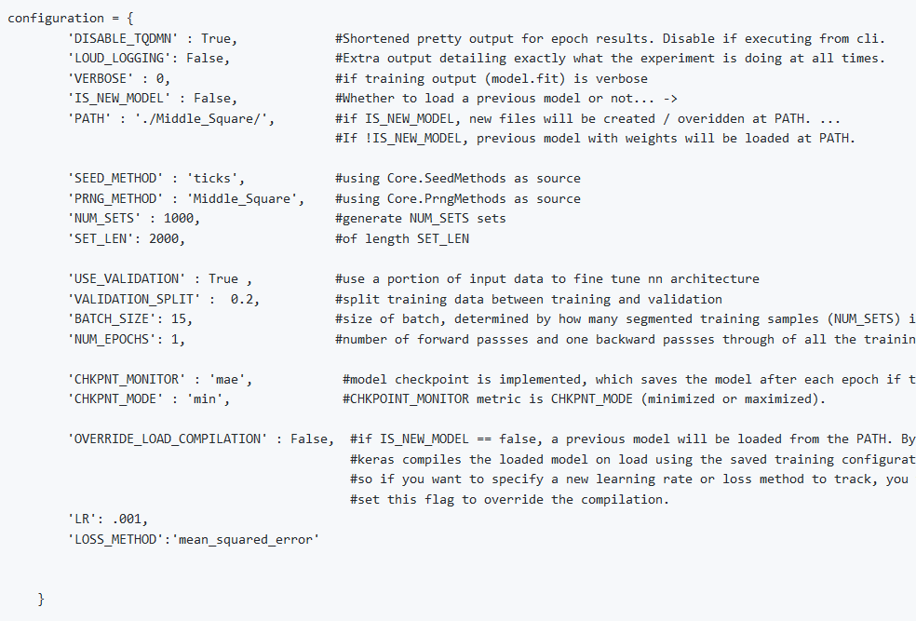
Experimental Framework and Logging
Notes:
Matthew and Spencer

Slide 8
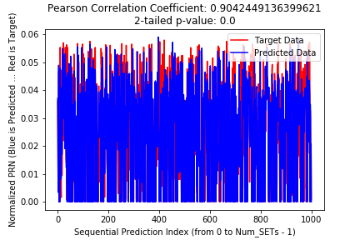
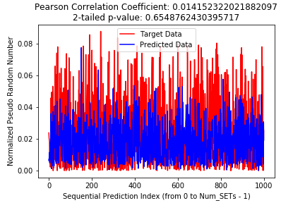
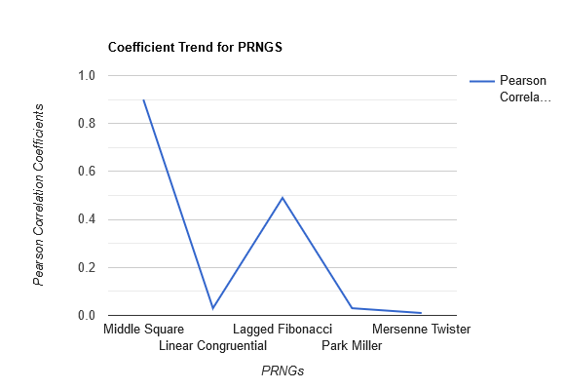
Results
Middle Square
Mersenne Twister
Notes:
Matthew and Spencer

